Slide 1
Development of a Diagonal Isometric Tensor Network Algorithm
Master‘s thesis
Benjamin Sappler
Supervisor: Prof. Dr. Frank Pollmann

Slide 2
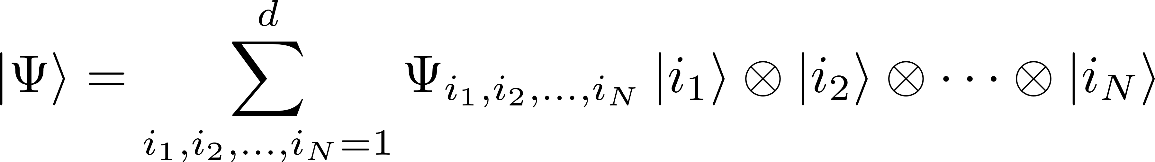
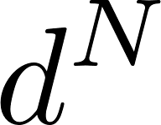
Simulation of QMB systems
Simulation of QMB systems is a hard problem
Fully describe wavefunction: parameters!
Approximations are needed!

Slide 3
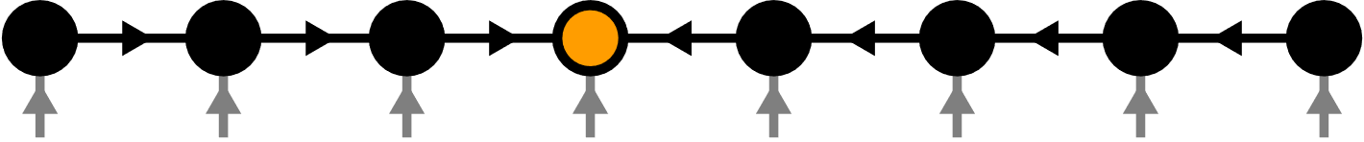
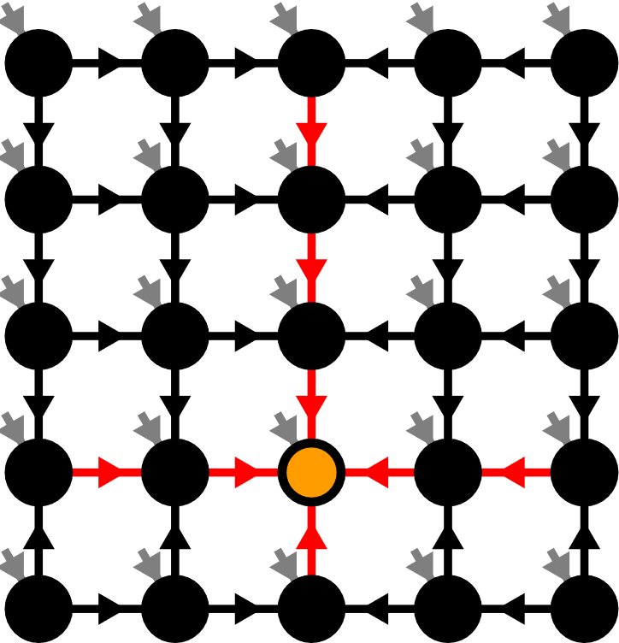
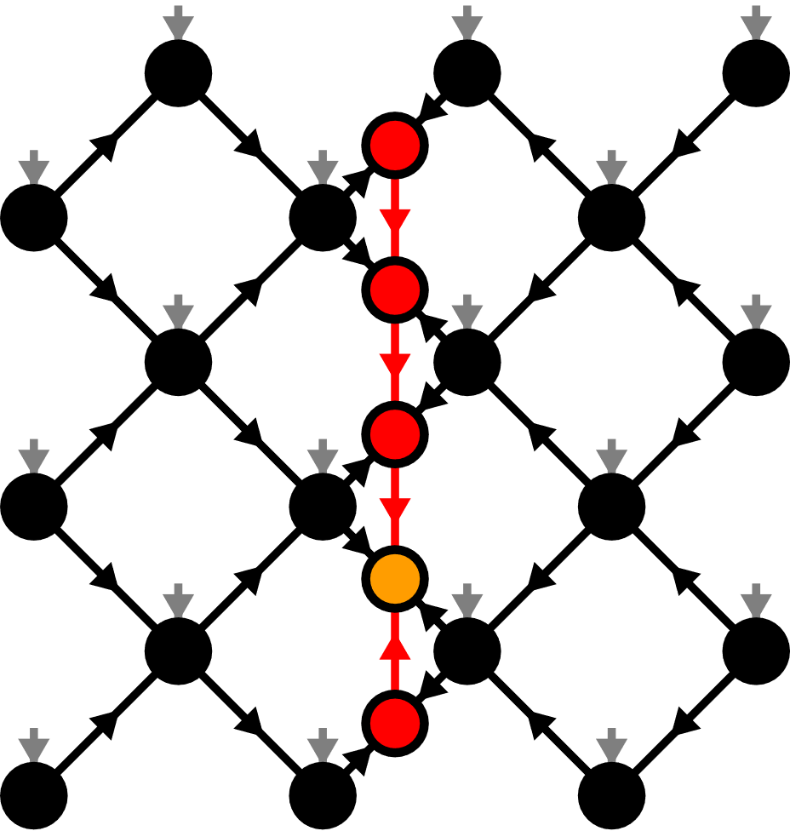
Contents
Matrix Product States (MPS)
Isometric Tensor Product States (isoTPS)
Alternative canonical form

Slide 4
Contents
Matrix Product States (MPS)
Isometric Tensor Product States (isoTPS)
Alternative canonical form

Slide 5

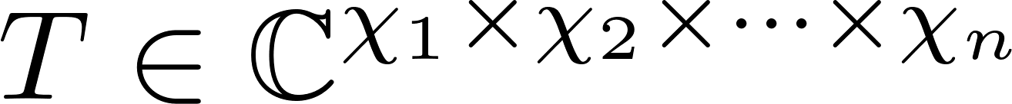
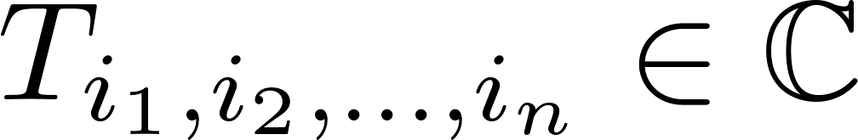
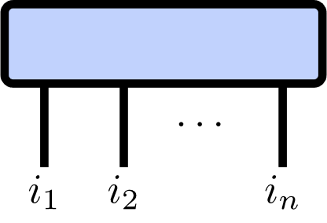
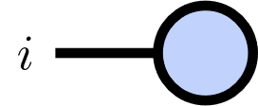
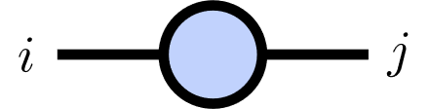
Tensor Networks
Tensor of rank :

Slide 6
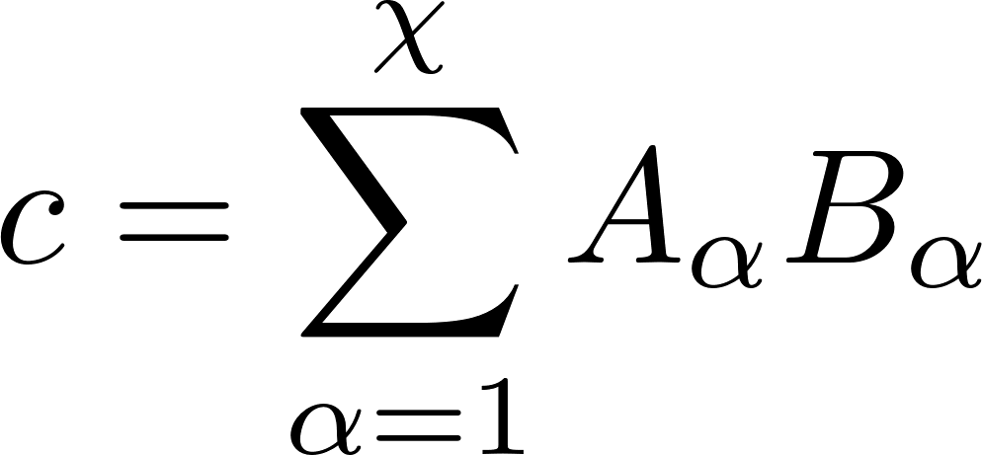
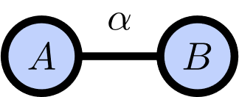
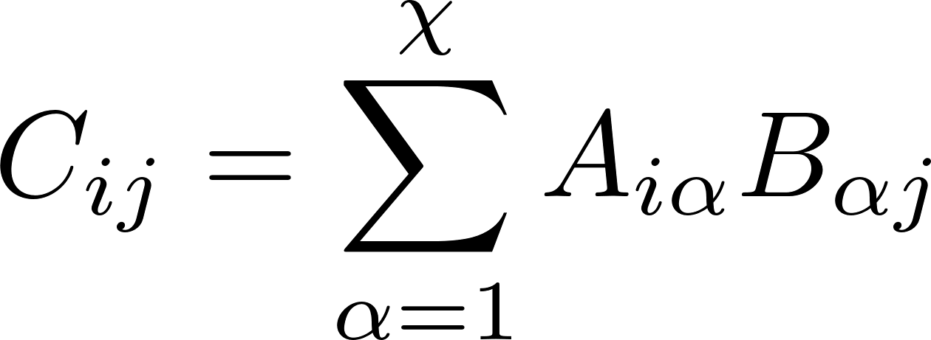
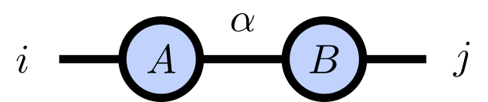
Index Contractions
Scalar product:
Matrix product:

Slide 7
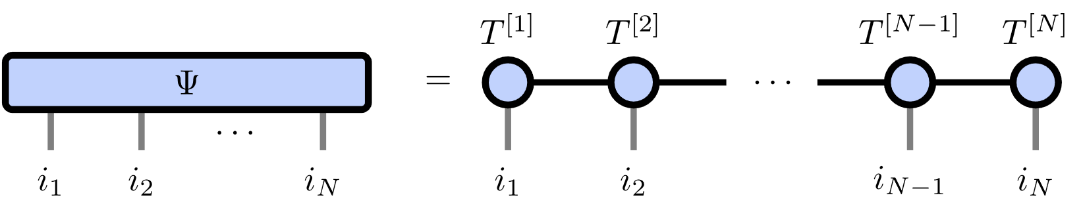
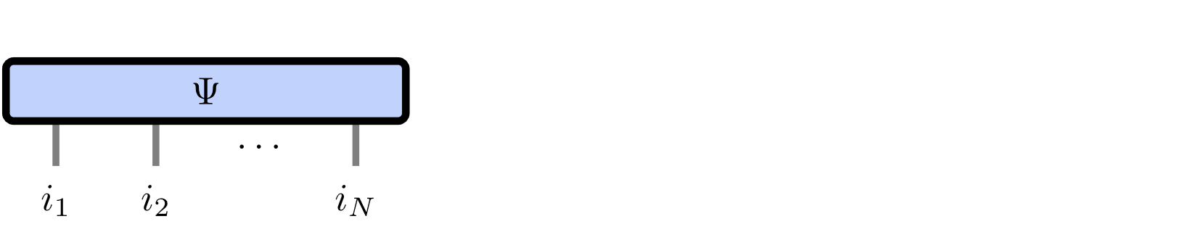
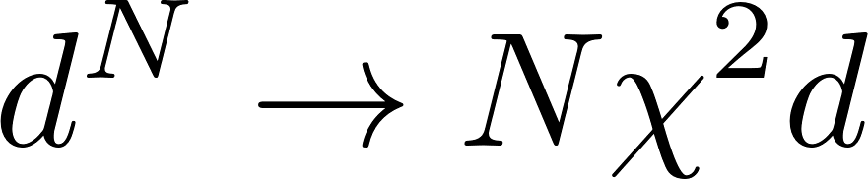
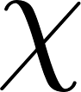
Matrix Product States
Number of parameters:
Represents area law states

Slide 8

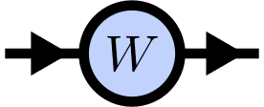
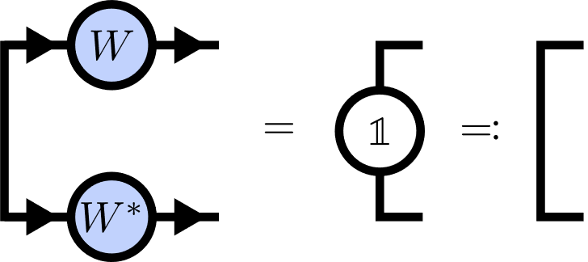
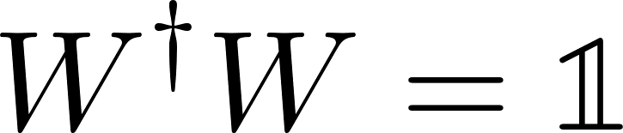
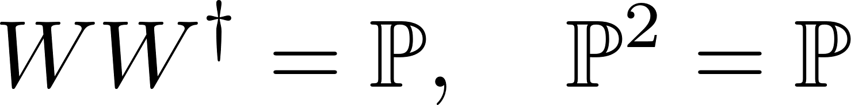
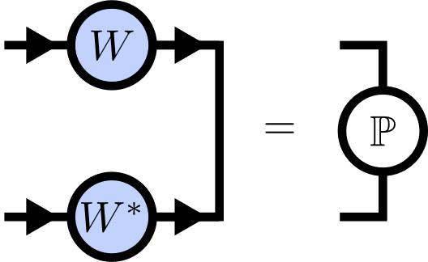
Isometries
Isometry:
Isometry condition:

Slide 9
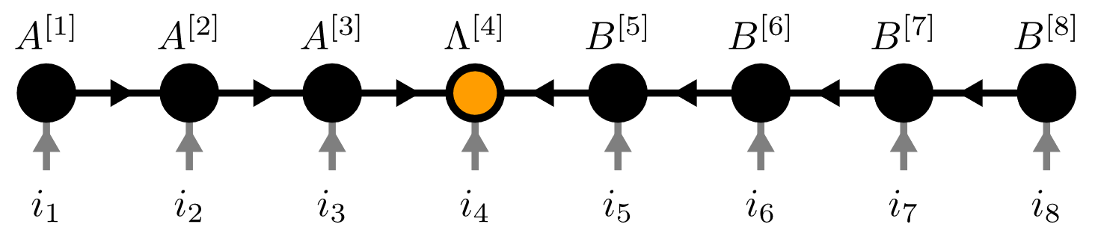
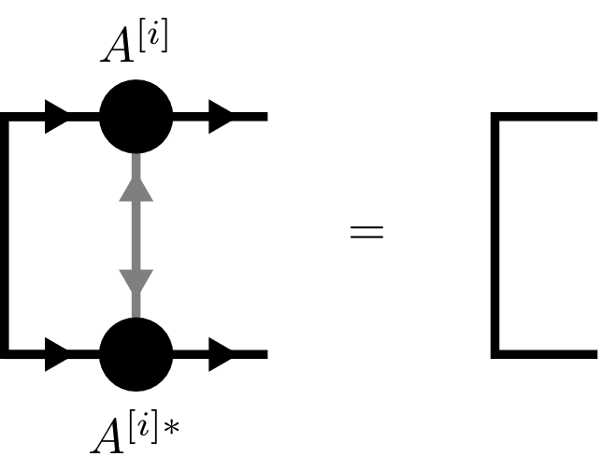
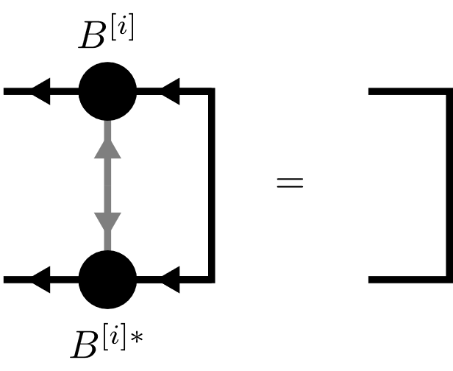
Canonical Form

Slide 10
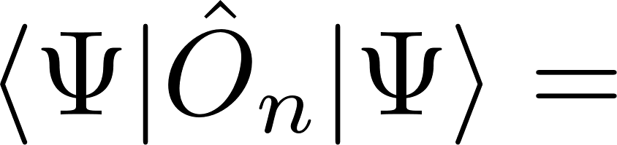
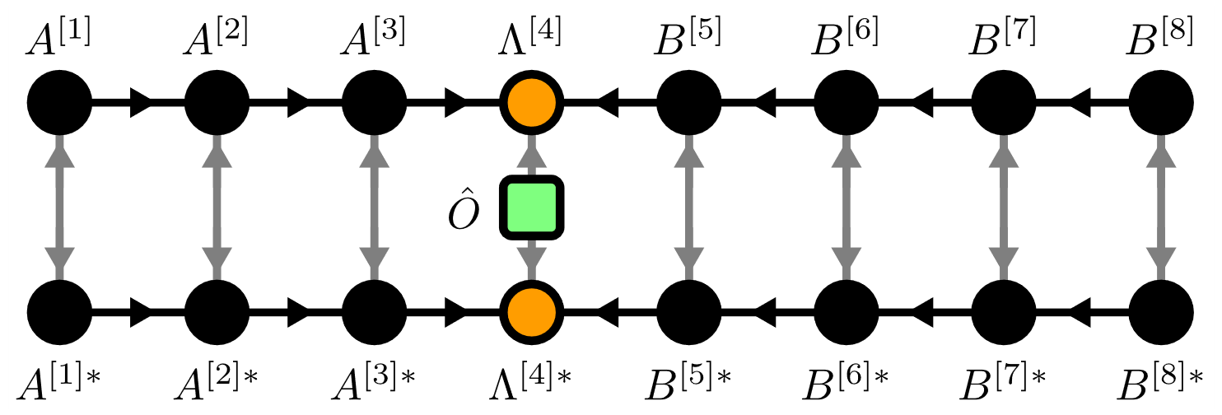

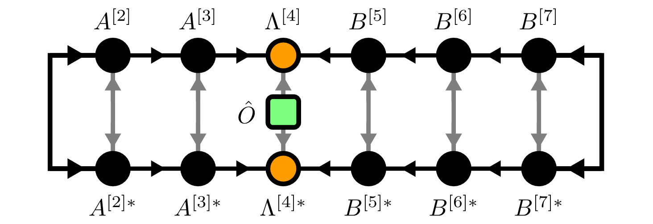
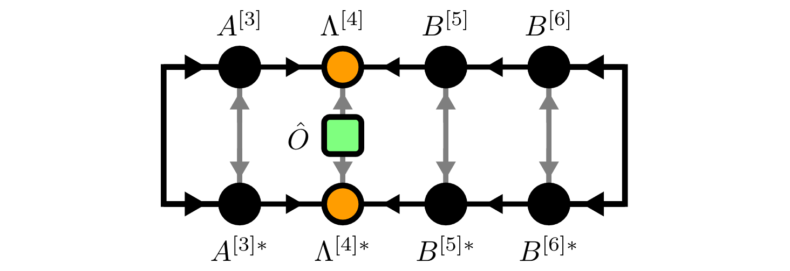

Local Expectation Values

Slide 11
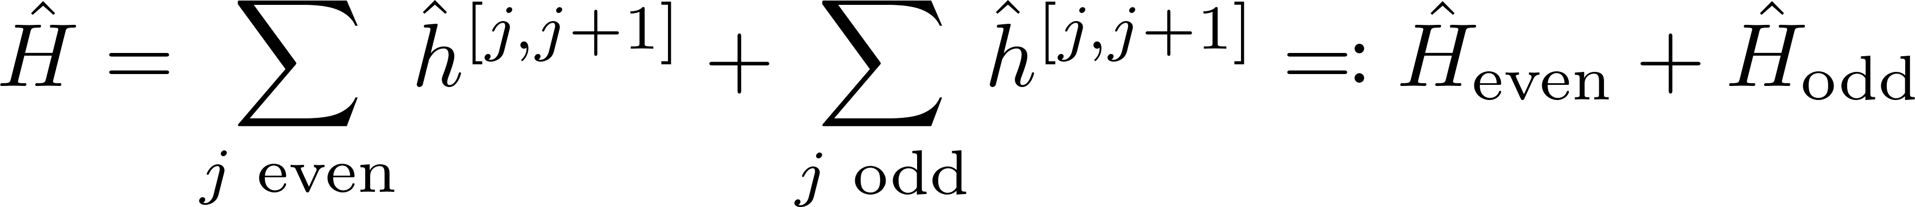
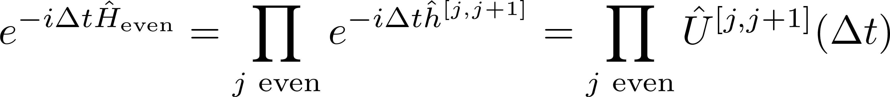
Time Evolving Block Decimation (TEBD)
Schrödinger equation:
Hamiltonian
Suzuki-Trotter decomposition:

Slide 12
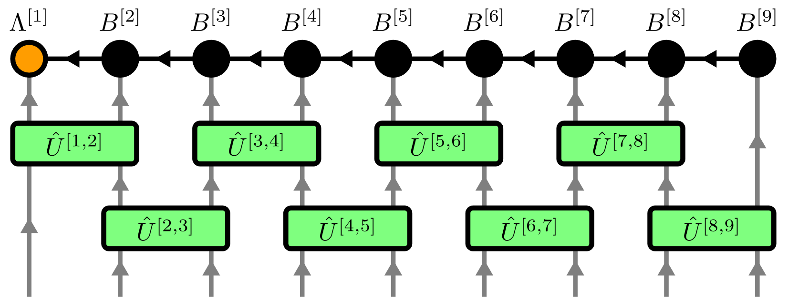
Time Evolving Block Decimation (TEBD)

Slide 13
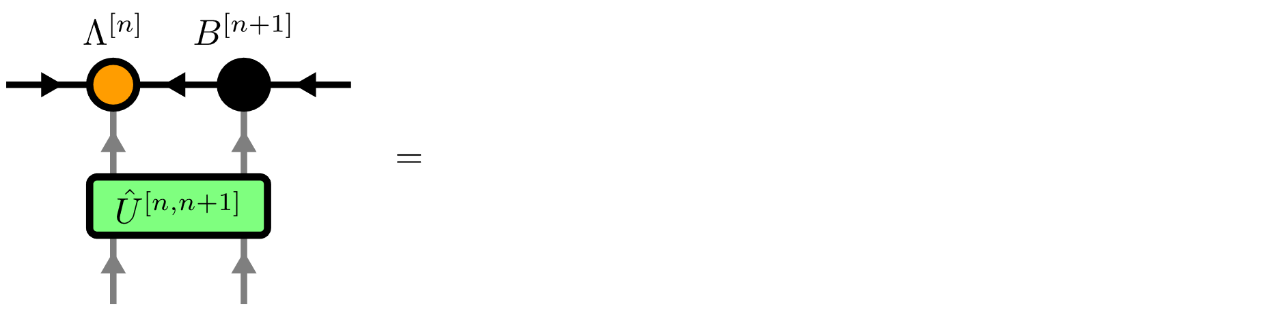
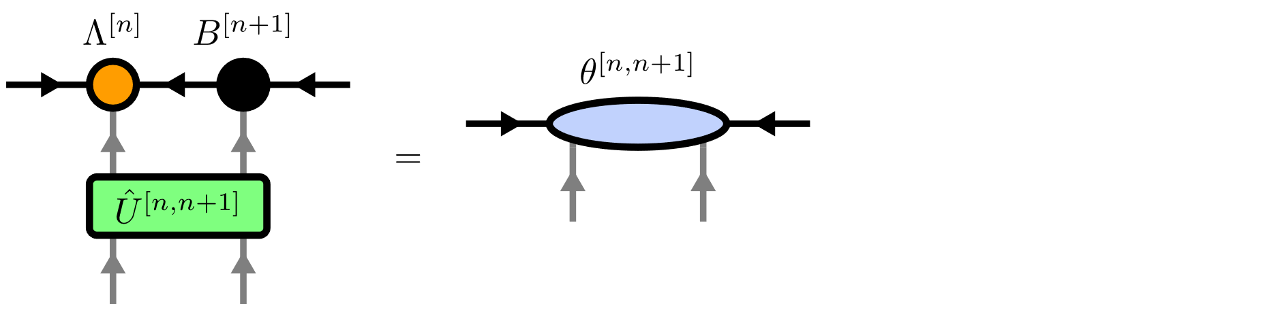
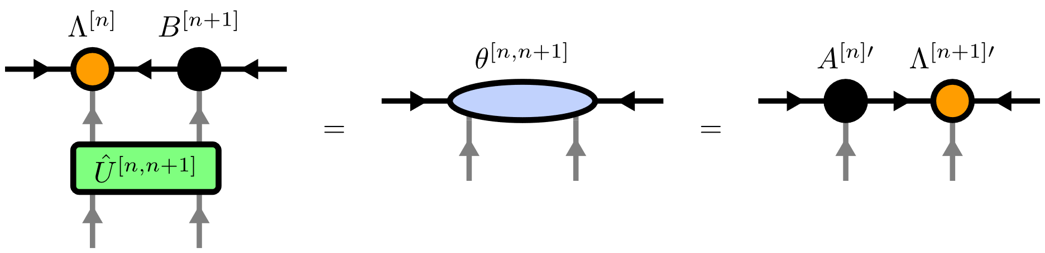
Time Evolving Block Decimation (TEBD)

Slide 14
Contents
Matrix Product States (MPS)
Isometric Tensor Product States (isoTPS)
Alternative canonical form

Slide 15
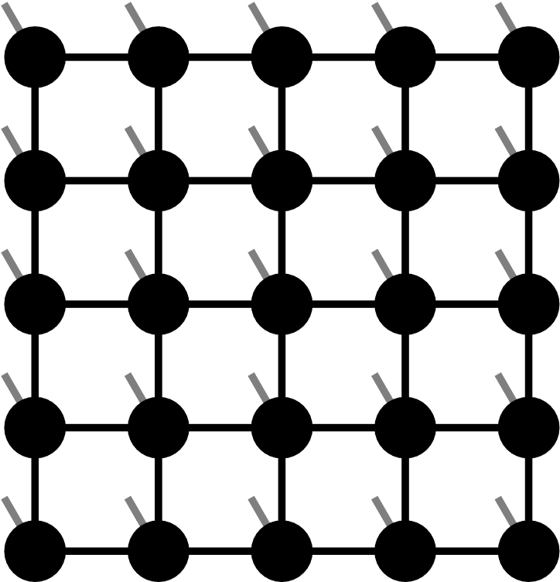

Projected Entangled Pair States (PEPS)

Slide 16
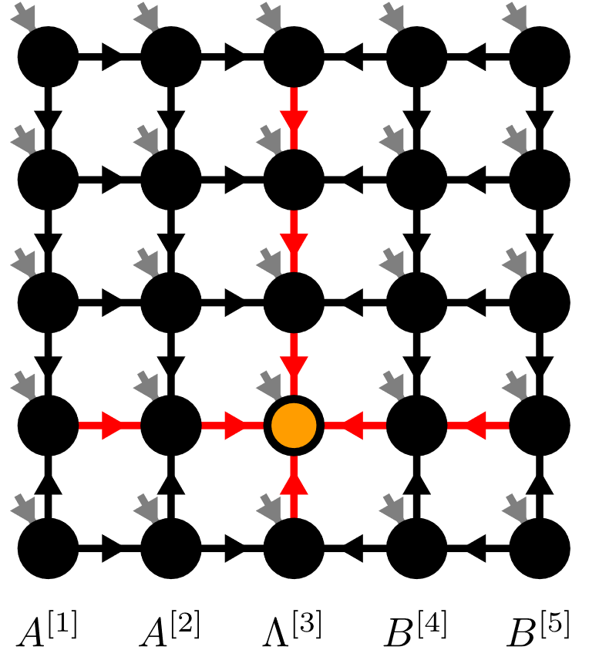
Isometric Tensor Product State

Slide 17
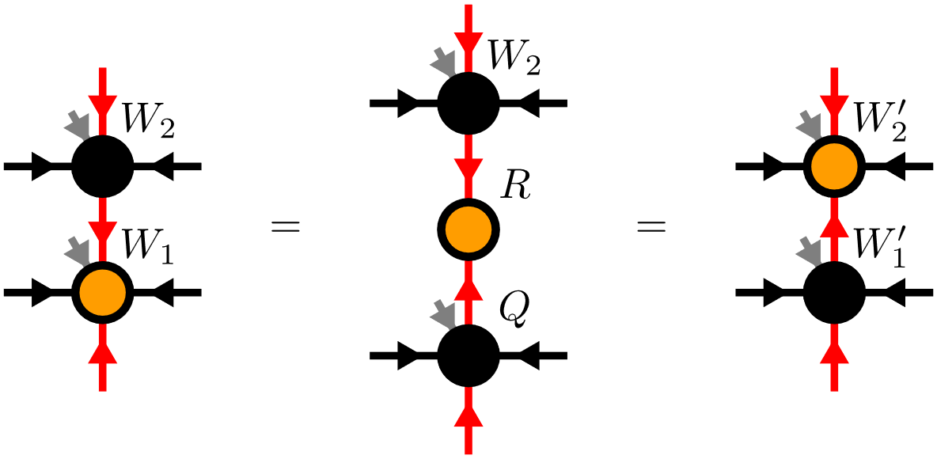
Moving the Orthogonality Center

Slide 18
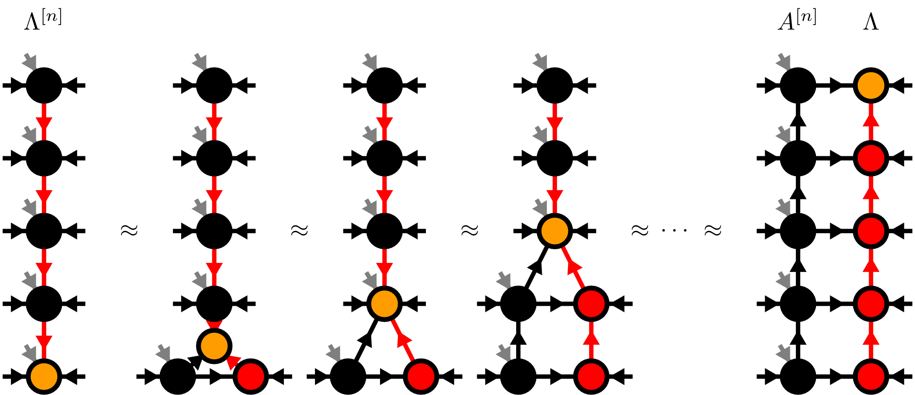
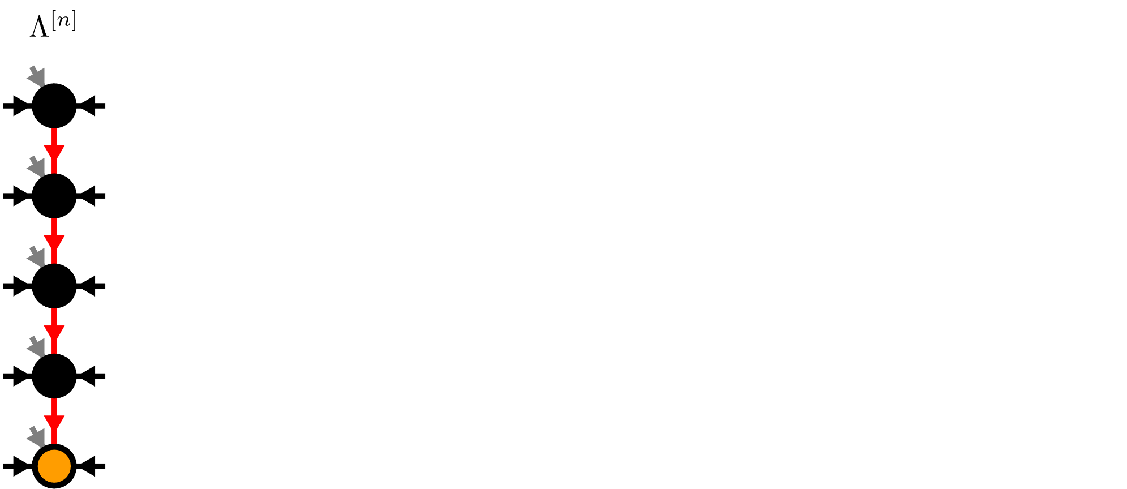
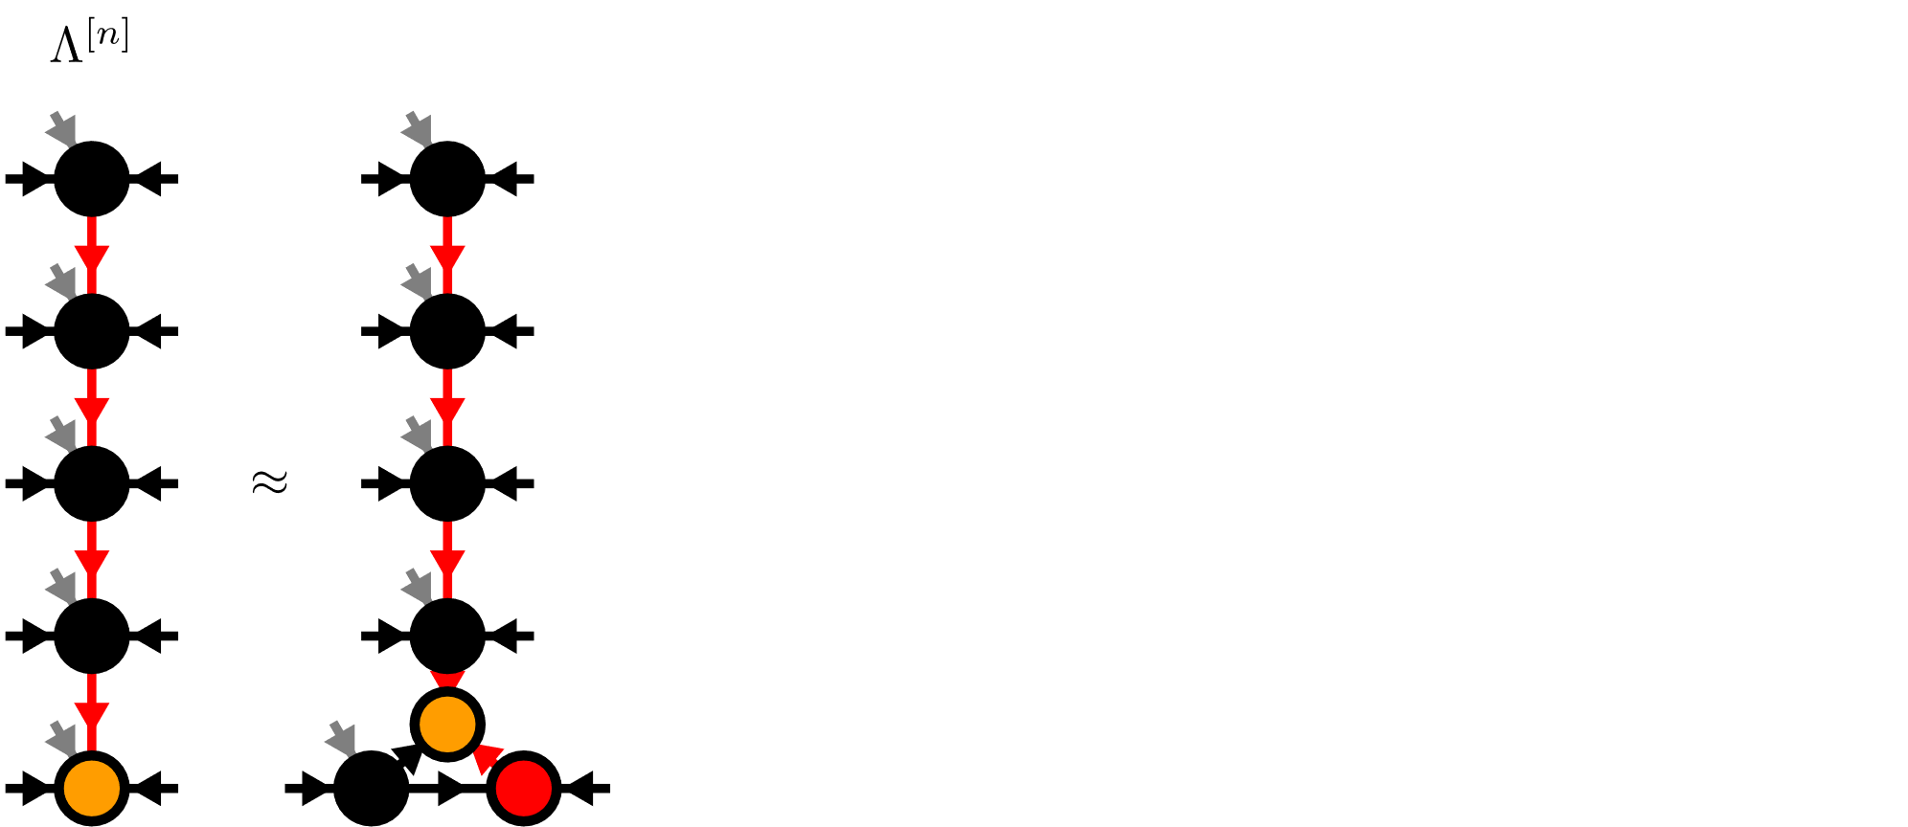
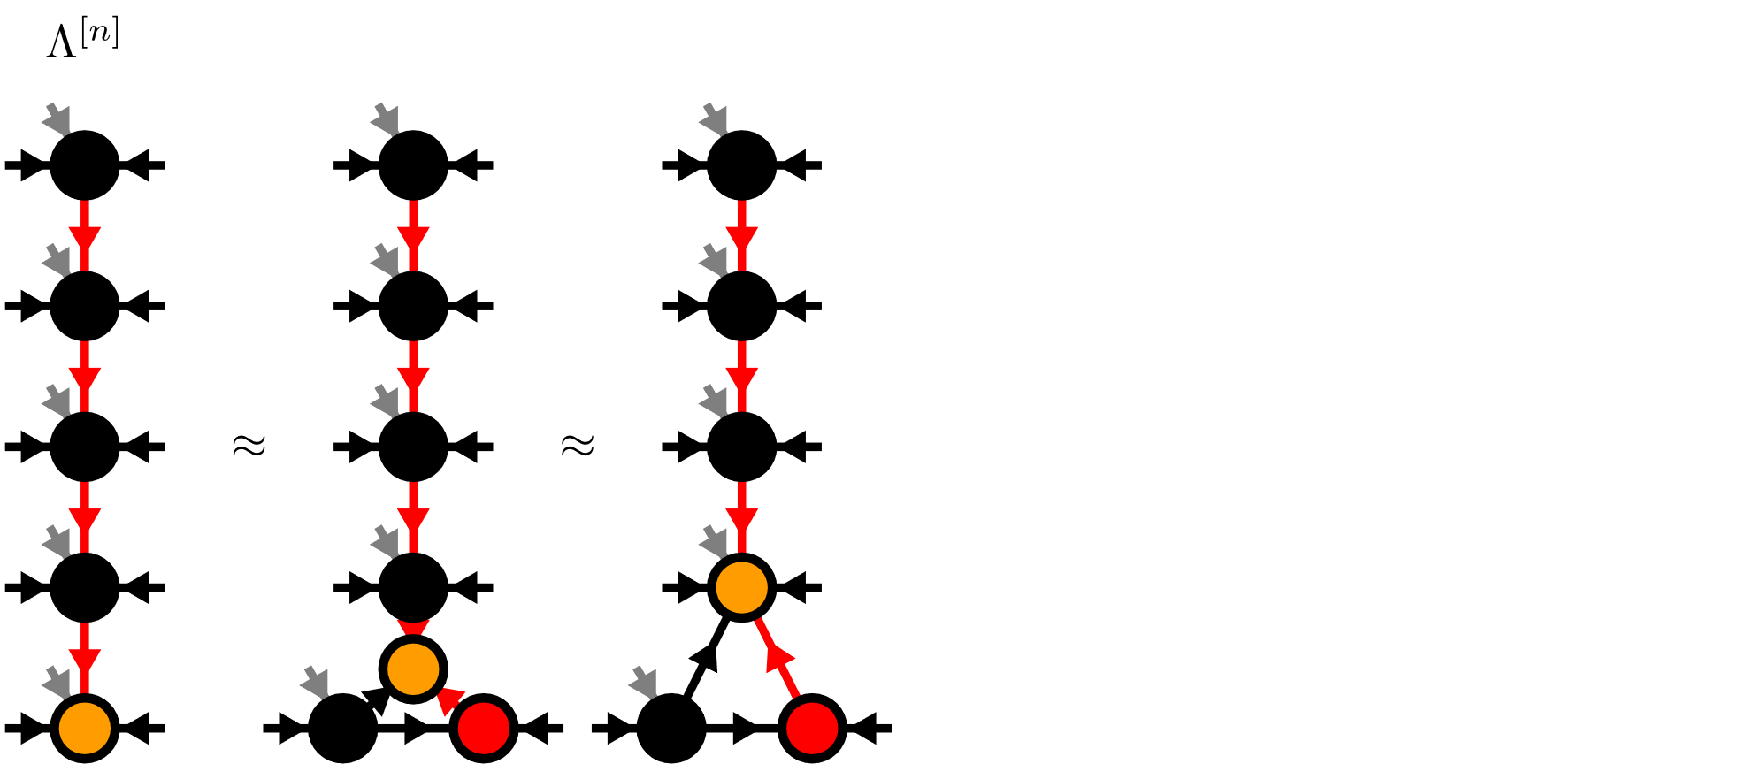
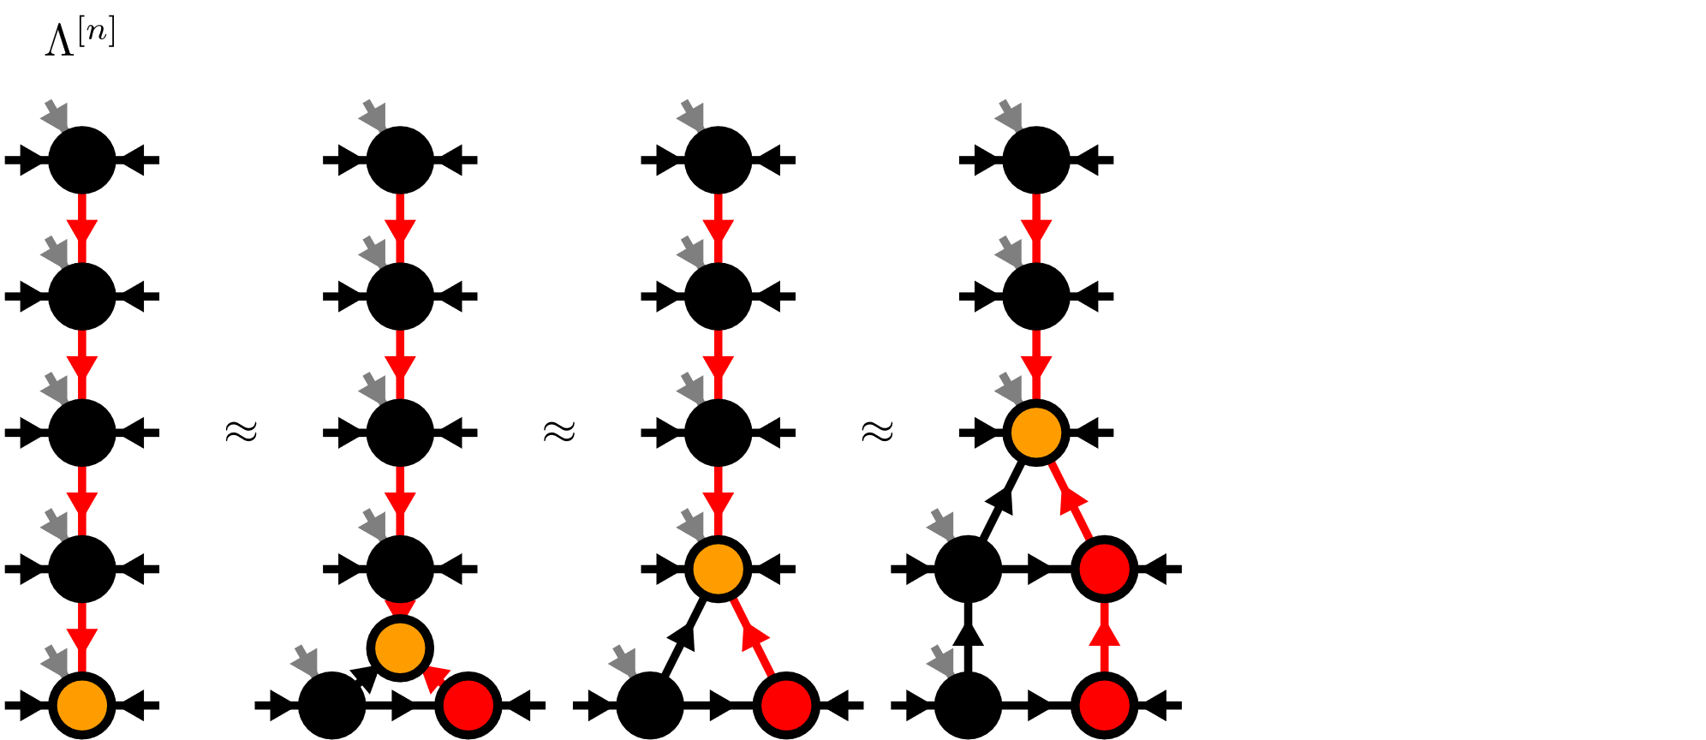
Moses-Move (MM)

Slide 19
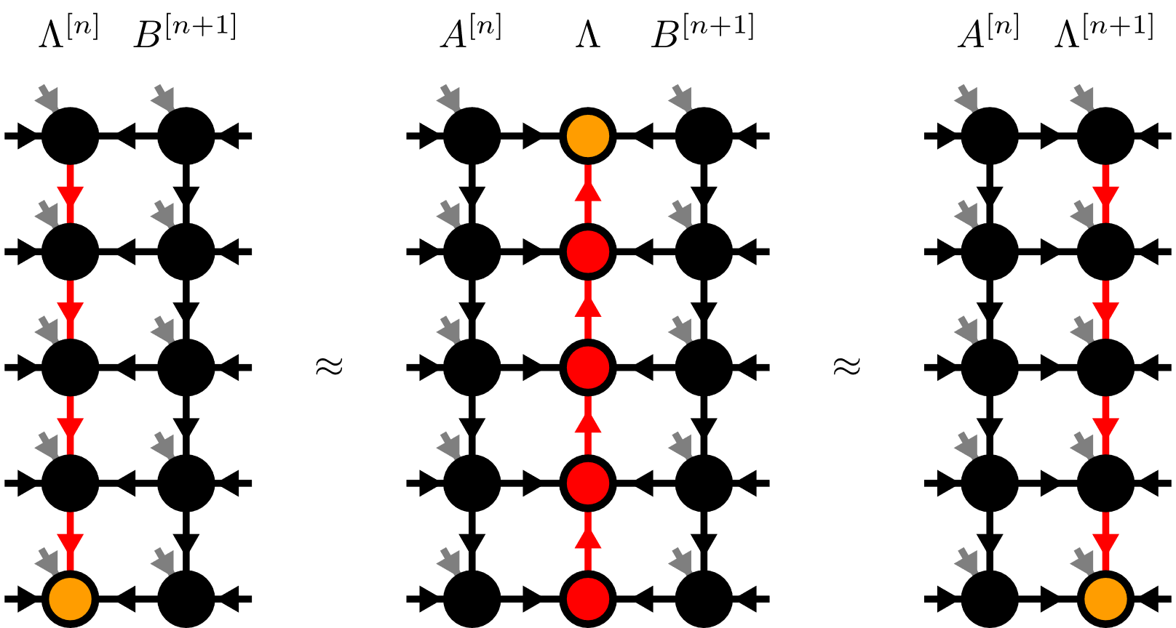
Moses-Move (MM)

Slide 20
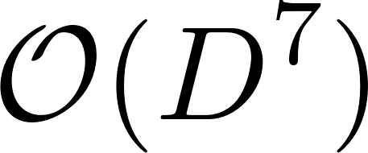
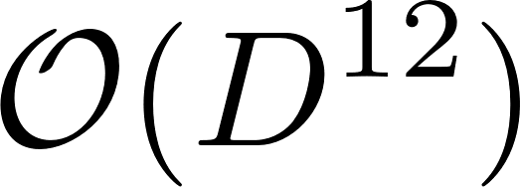
Algorithms on isoTPS
TEBD:
DMRG:
But no generalized eigenvalue problem!

Slide 21
Contents
Matrix Product States (MPS)
Isometric Tensor Product States (isoTPS)
Alternative canonical form

Slide 22
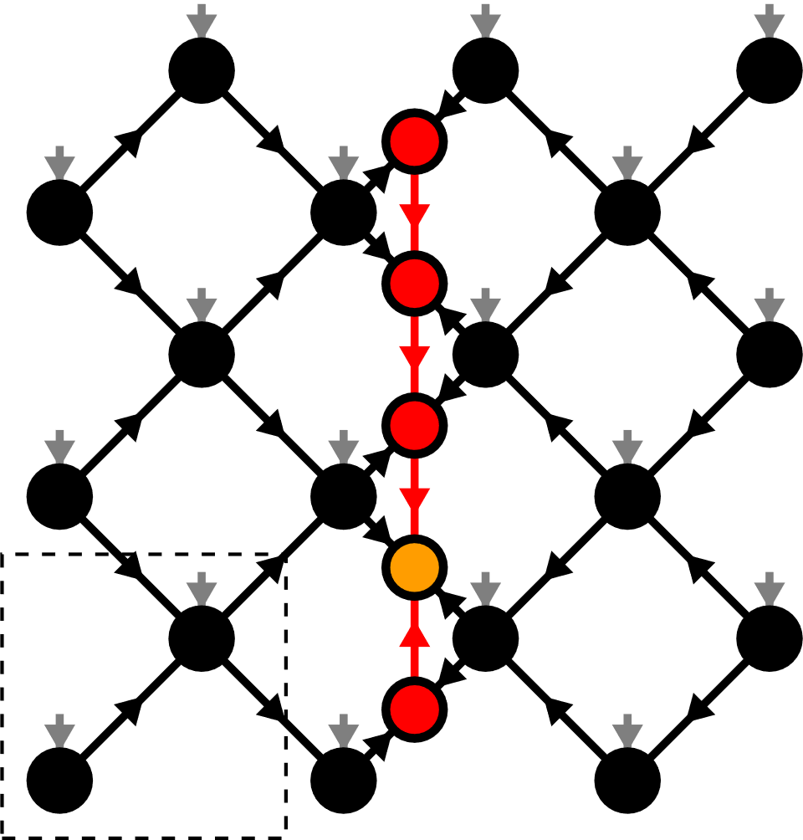
Alternative canonical form

Slide 23
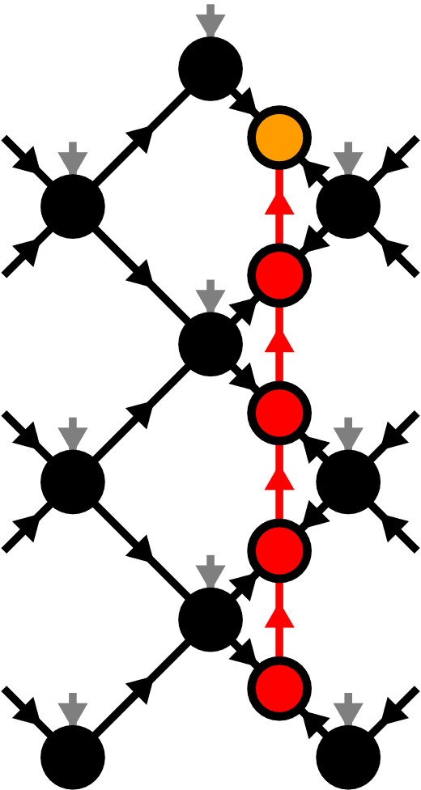
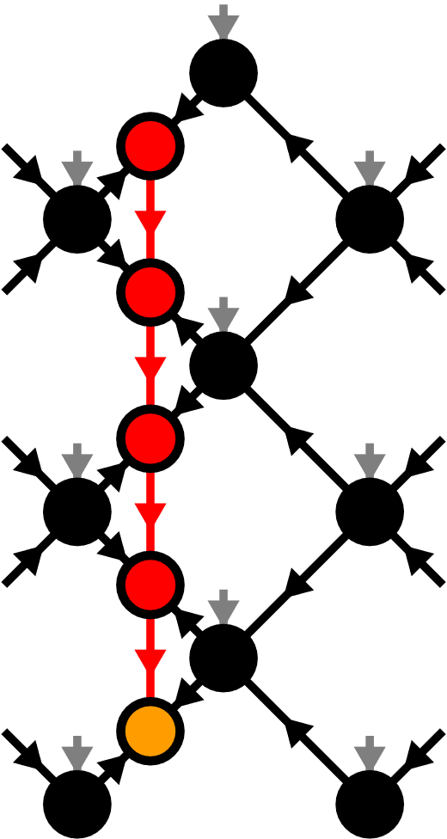




Moving the orthogonality hypersurface

Slide 24



Yang-Baxter (YB) Move
YB Error

Slide 25

Yang-Baxter (YB) Move
Constrained optimization problem
Two algorithms:
Variational optimization with local updates
Tripartite decomposition using SVD + disentangling

Slide 26


YB-move: Variational optimization

Slide 27

YB-move: Variational optimization

Slide 28






YB-move: Tripartite decomposition

Slide 29

Disentangling procedure

Slide 30





Disentangling procedure
Minimize the Rényi-entropy
Bounds truncation error for
In practice: Good results also for

Slide 31




Renyi-2 disentangling
Cost function:
Evenbly-Vidal algorithm:
maximize

Slide 32

Renyi-2 disentangling

Slide 33





Riemannian optimization
No easy tensor network form for
Use Riemannian optimization!

Slide 34


Riemannian optimization
Computing Gradient costs

Slide 35





Approximate Gradients

Slide 36

Approximate Gradients

Slide 37



TEBD: Local updates
Apply local bond operator:
Optimization problem:

Slide 38


TEBD: Local updates

Slide 39







TEBD1

Slide 40
TEBD1 vs TEBD2
First order:
Second order:
with the same number of YB moves!

Slide 41


Transverse Field Ising (TFI) model
Critical field

Slide 42

Ground state search with imaginary TEBD
Imaginary TEBD can be used to find ground states
TEBD error:
Best results:
Reference Simulation: DMRG with tenpy

Slide 43




Comparing YB-move algorithms

Slide 44


TEBD1 vs TEBD2

Slide 45




Larger lattices

Slide 46



Larger lattices

Slide 47

Real-time evolution: Global quench

Slide 48


Summary & Outlook
Alternative canonical form
YB-move:
Easily generalizable to other lattices
TEBD algorithm for time evolution
Numerical evidence for 2D area law states
Outlook:
DMRG
Thermodynamic limit
GPUs

Slide 49




Moses-Move (MM) – Tripartite Decomposition

Slide 51

Isometric Tensors

Slide 52


Local Expectation Values

Slide 53






TEBD2

